Slide 1






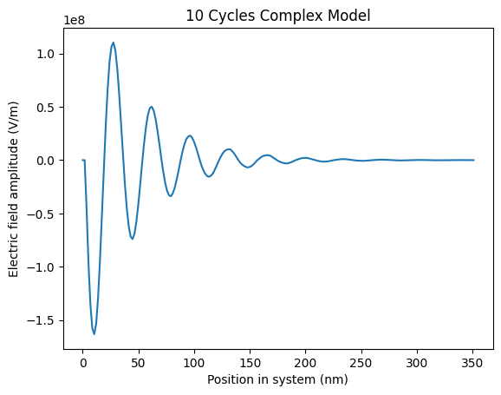
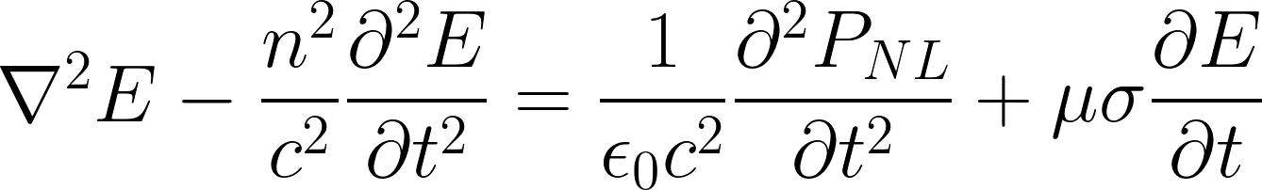
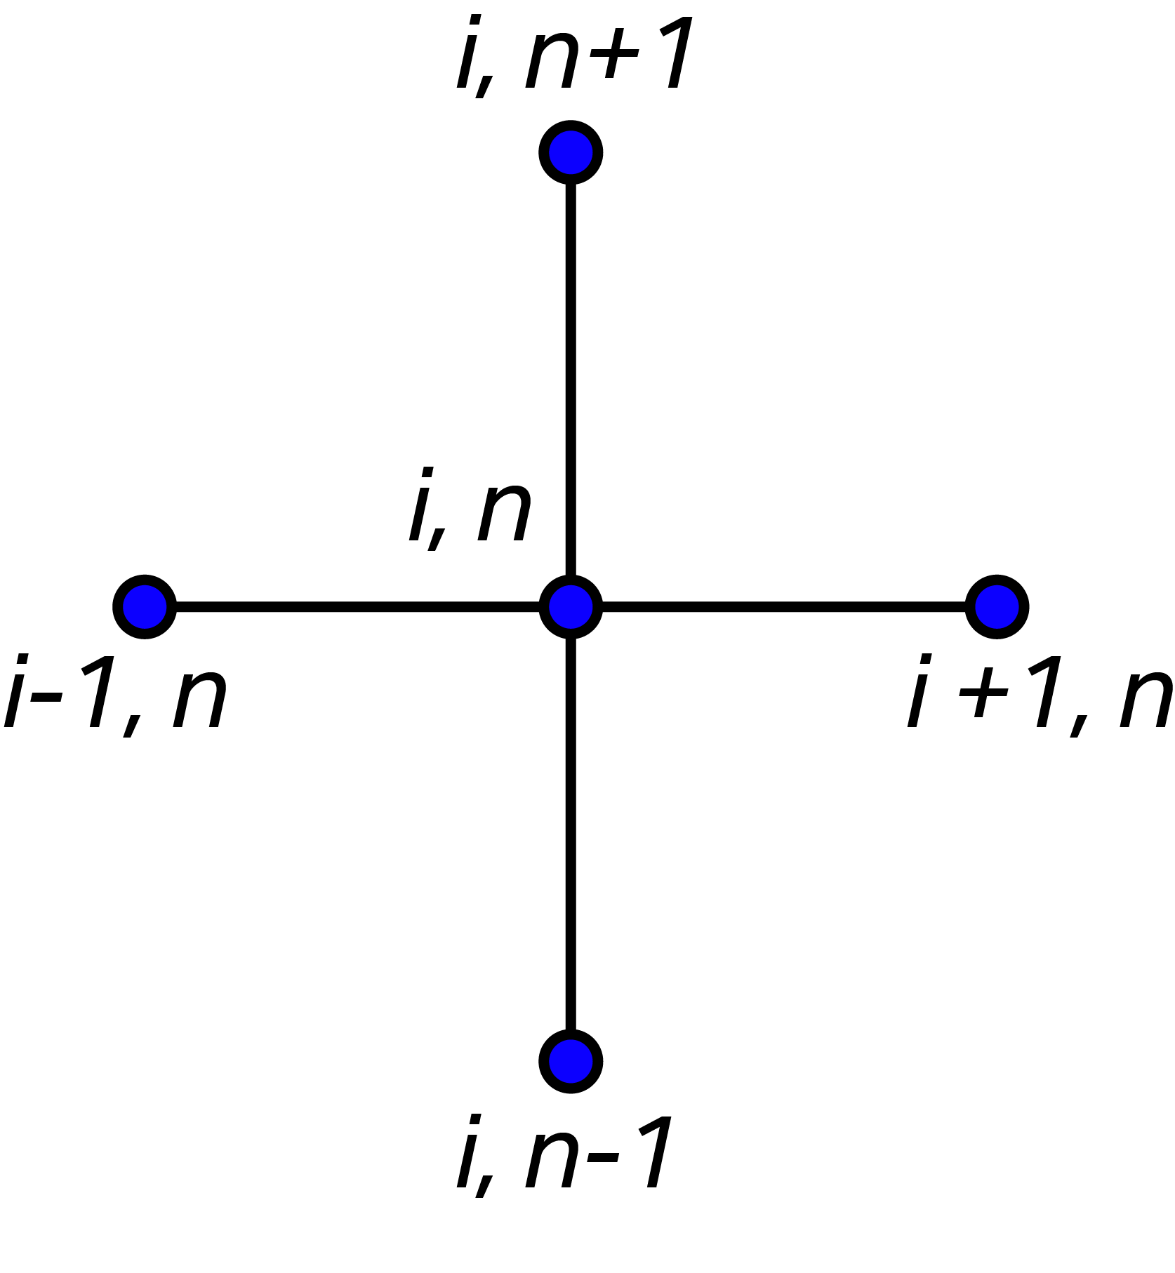
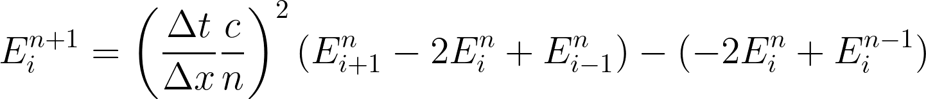
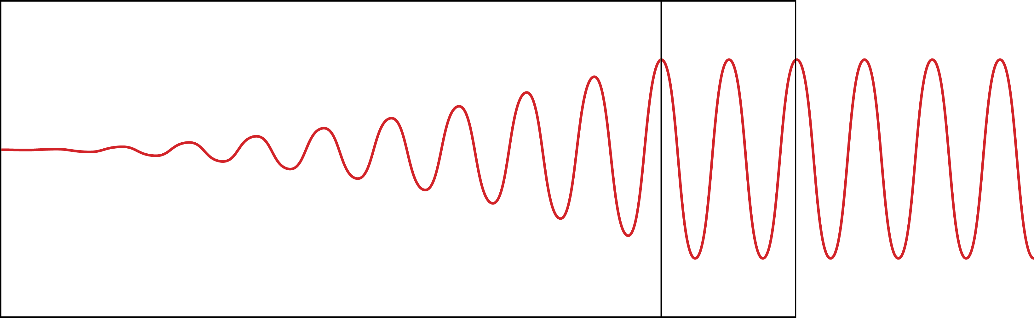
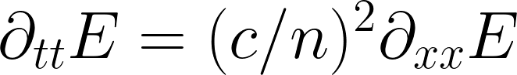
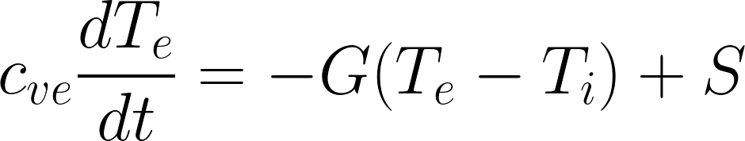
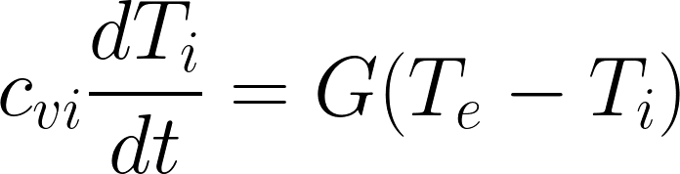
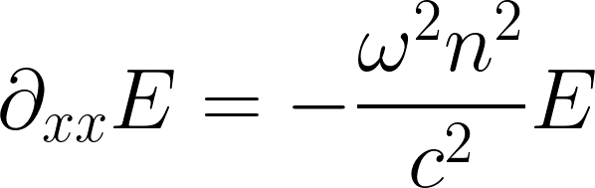
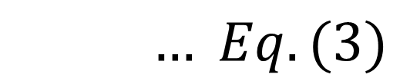
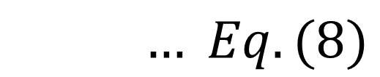
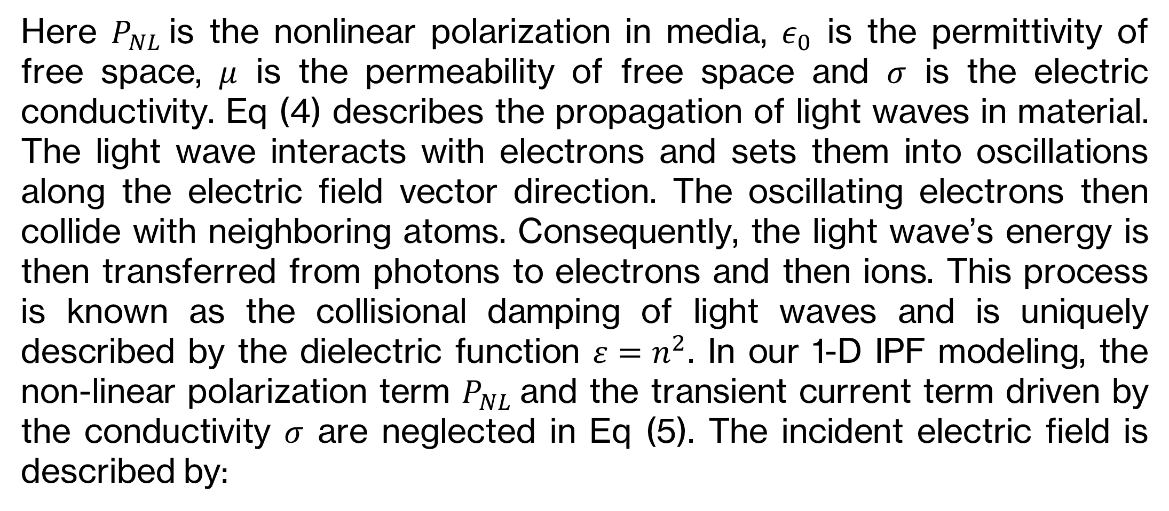
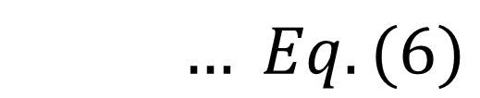
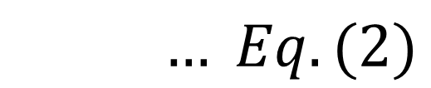
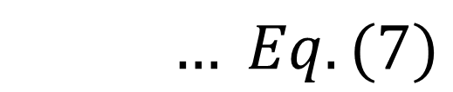
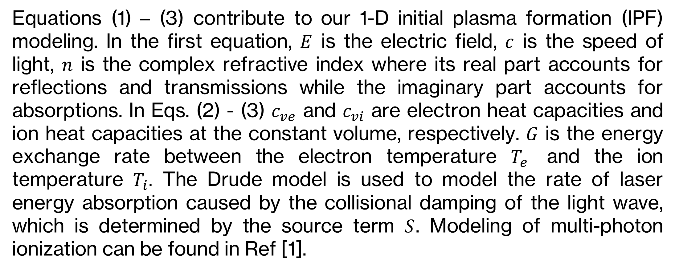
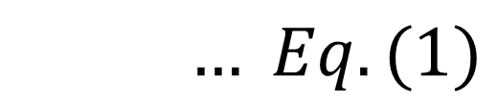
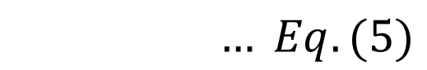
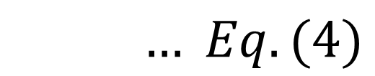
Implementation of a One-Dimensional Electromagnetic Wave Solver in Initial Plasma Formation Modeling
Nicholas Davila¹, Ka Ming Woo² ¹Department of Physics, College of Natural Sciences, The University of Texas at Austin
¹Princeton Plasma Physics Laboratory
²Laboratory for Laser Energetics, University of Rochester
Abstract
Methods and Figures
Conclusion and Results
The modeling of initial plasma formation (IPF) provides a pathway for understanding the ultrafast dynamics of laser–material interactions. A one-dimensional electromagnetic wave solver has been developed using the finite-difference time-domain (FDTD) method to accurately model laser propagation in metals and dielectrics. Laser absorption is modeled by the collisional damping of the light wave, which is determined by the dielectric function of the materials. A two-temperature model is employed to describe the heat transfer between electrons and lattices/ ions. Differences in the heat transfer dynamics to electrons and ions modeled by the wave solver and a ray trace approach are compared. The objective of this approach is to enhance the modeling accuracy of laser-matter interactions in inertial confinement fusion (ICF) codes.
The explicit Finite-Difference Time-Domain (FDTD) scheme was implemented to model the electromagnetic wave propagation in medium. The explicit scheme imposes a constraint on the time-step size “dt” so that the wave propagation distance within an allowed time-step size cannot exceed the grid size “dx” according to the Courant–Friedrichs–Lewy (CFL). The allowed wave propagation step size within a grid size “dx” is controlled by the CFL number.
$$… Eq. (4)$$
Figure 2: Stencil diagram of the explicit finite difference scheme
Background
$$… Eq. (5)$$
GHOST CELL
Figure 3: Simulation of light wave propagating into material undergoing collisional damping.
SIMULATION SPACE
Here $P_{NL}$is the nonlinear polarization in media, $ε_{0}$ is the permittivity of free space, $μ$ is the permeability of free space and $σ$ is the electric conductivity. Eq (4) describes the propagation of light waves in material. The light wave interacts with electrons and sets them into oscillations along the electric field vector direction. The oscillating electrons then collide with neighboring atoms. Consequently, the light wave’s energy is then transferred from photons to electrons and then ions. This process is known as the collisional damping of light waves and is uniquely described by the dielectric function $ε=n^{2}$. In our 1-D IPF modeling, the non-linear polarization term $P_{NL}$and the transient current term driven by the conductivity $σ$ are neglected in Eq (5). The incident electric field is described by:
The 1-D electromagnetic wave solver was implemented over 10 cycles for a complex refractive index n = n_R + n_I = 1 + 0.125 and wavelength lambda = 351 nm. As shown in Fig. (3) we were able to accurately model the attenuation of the 1-D light wave propagating into a material. We are currently implementing a time-skipping strategy to speed up the code. Eventually will be implemented into ICF code and run by supercomputers.
Figure 1: Diagram of laser propagation and its interaction with material. This was the outcome we were looking for. The modeling equations are given below.
Future Work
$$… Eq. (1)$$
For future work, we can extend our solver into 2-D and 3-D to model the multi-dimensional wave propagation. We also plan to employ a two-temperature model to study and compare the heat transfer dynamics in material modeled by the wave solver and the ray tracing approach.
$$… Eq. (6)$$
$$… Eq. (2)$$
The complex-valued incident electric field provides the initial boundary condition in the ghost cells, whereas the electric field inside the computational domain is initialized as zeroes. The Fourier analysis is applied to model the amplitude of the electric field vector. In 1-D, the reduced wave equation becomes:
References
$$… Eq. (3)$$
[1] L. V. Keldysh “Ionization in the Field of a Strong Electromagnetic Wave and modern physics of atomic interaction with a strong laser field” Journal of Experimental and Theoretical Physics, 122, 449–455 (2016).
Equations (1) – (3) contribute to our 1-D initial plasma formation (IPF) modeling. In the first equation, $E$ is the electric field, $c$ is the speed of light, $n$ is the complex refractive index where its real part accounts for reflections and transmissions while the imaginary part accounts for absorptions. In Eqs. (2) - (3) $c_{ve}$ and $c_{vi}$ are electron heat capacities and ion heat capacities at the constant volume, respectively. $G$ is the energy exchange rate between the electron temperature $T_{e}$ and the ion temperature $T_{i}.$ The Drude model is used to model the rate of laser energy absorption caused by the collisional damping of the light wave, which is determined by the source term $S$. Modeling of multi-photon ionization can be found in Ref [1].
$$… Eq. (7)$$
Equation (7) accepts an exponentially decaying or growing solution. A positive sign in the refractive index corresponds to a growing wave amplitude whereas the negative sign corresponds to a decaying wave amplitude. In the absence of wave amplification processes caused by the nonlinear polarization effect, the negative sign is the correct solution to describe an attenuating wave for laser propagations in material. During the numerical update, the selection of the sign depends on the boundary condition.
Acknowledgments
This material is supported by the Department of Energy National Nuclear Security Administration under Award No. DE-NA0003856. This work was made possible by funding from the Department of Energy for the Plasma and Fusion Undergraduate Research Opportunities (PFURO) program. This work is supported by the US DOE Contract No. DE-AC02-09CH11466.
$$… Eq. (8)$$

Slide 2
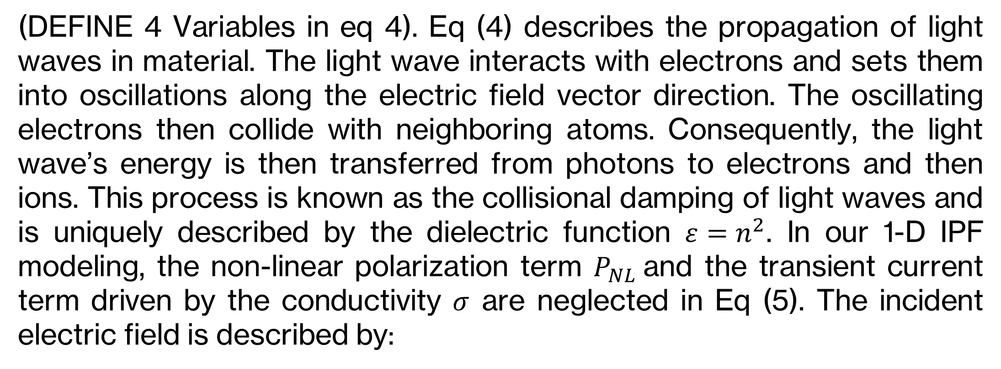
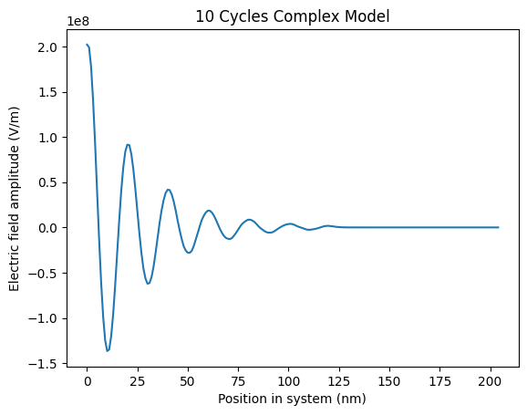
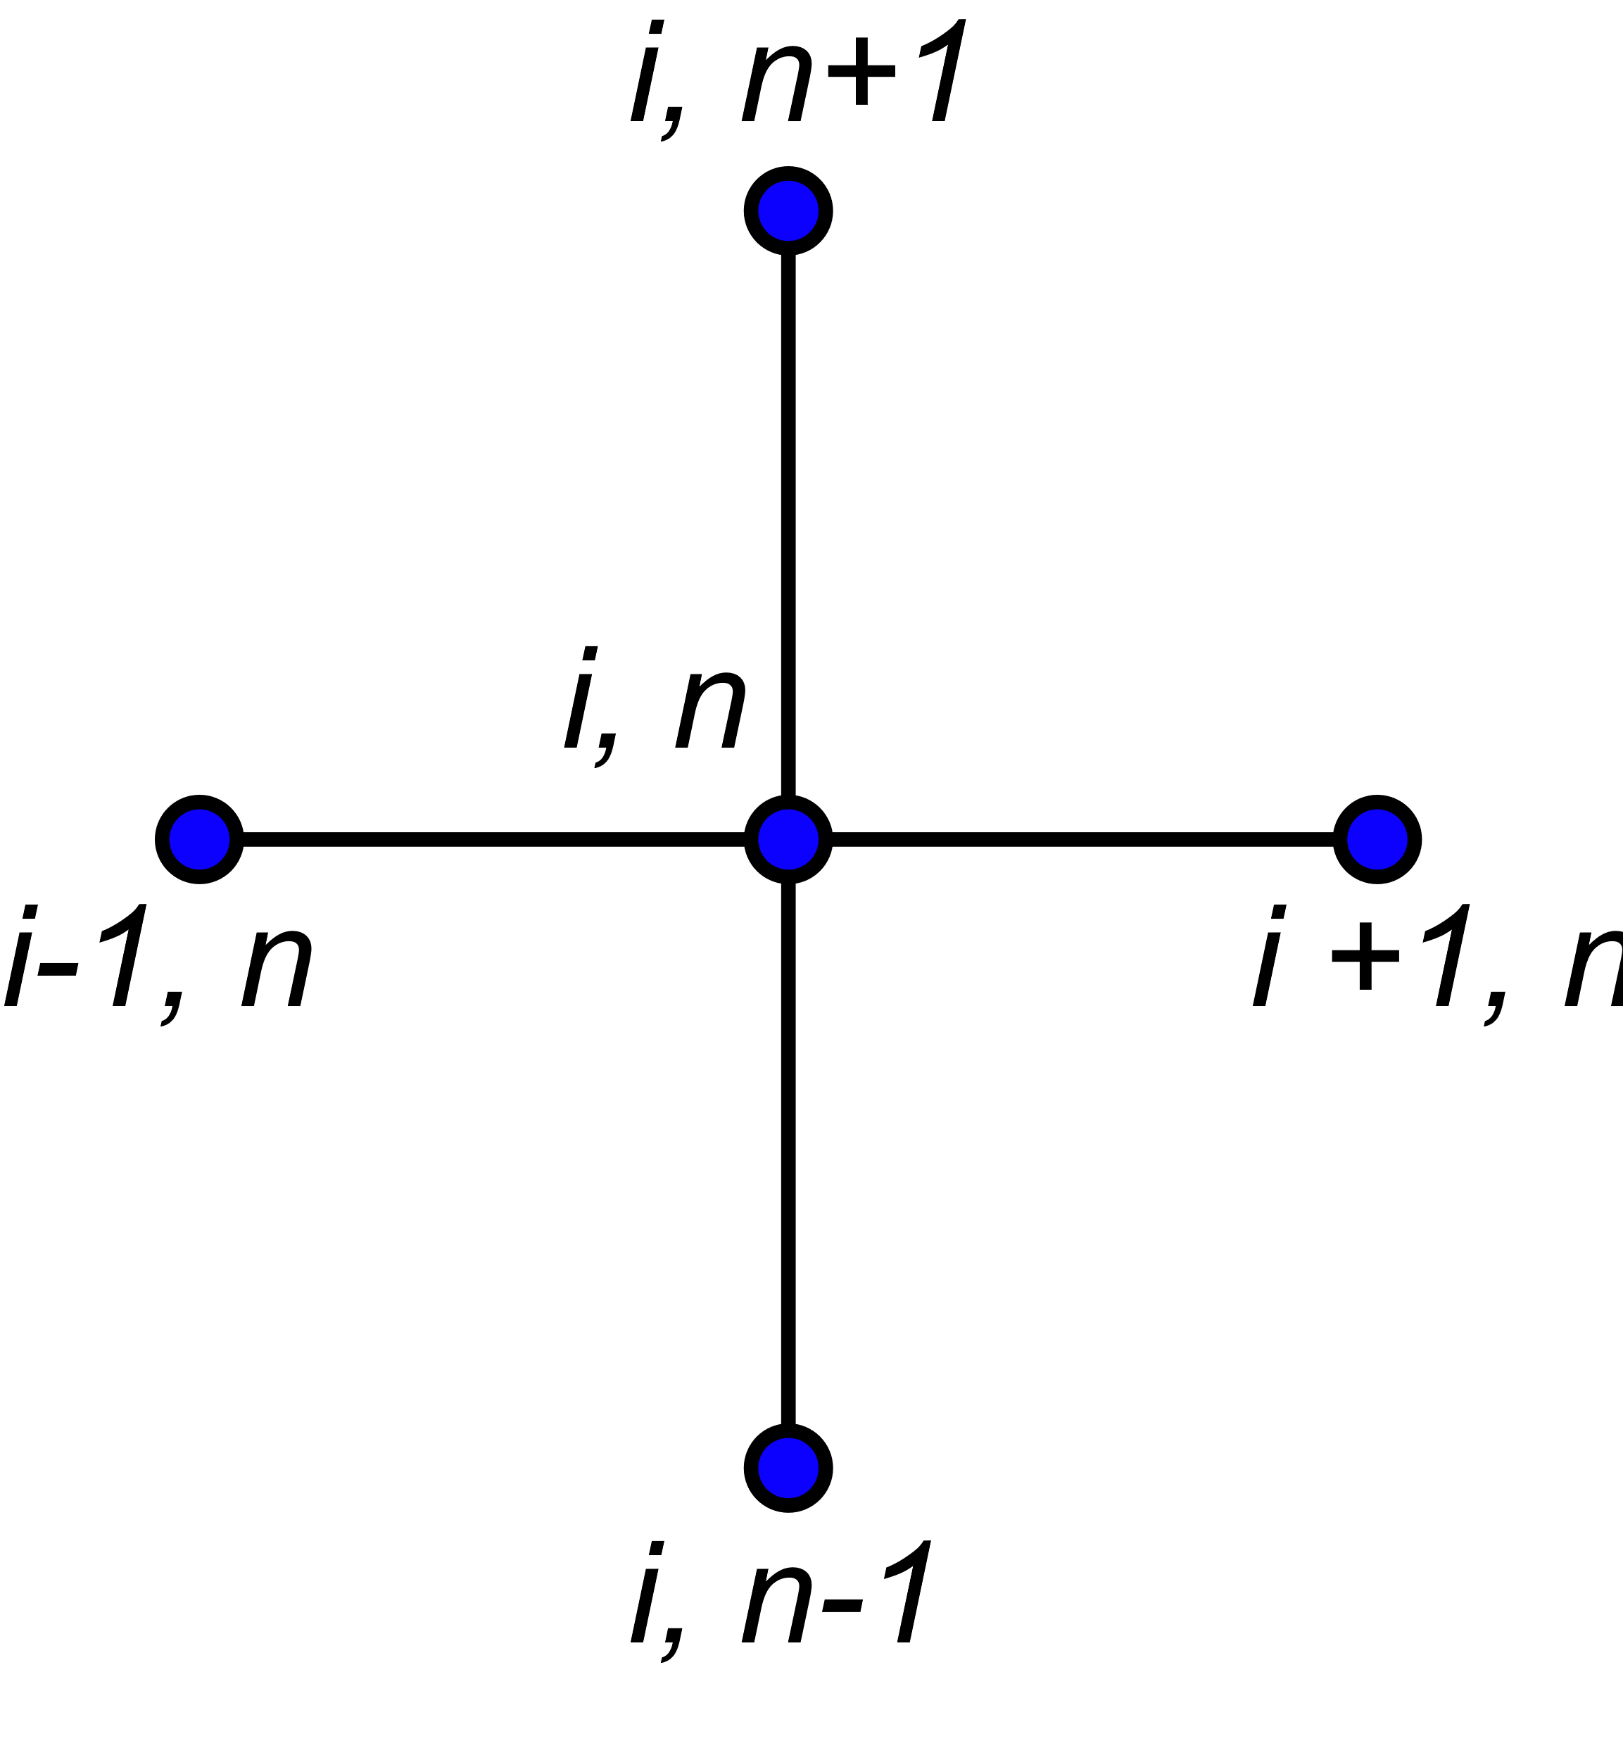
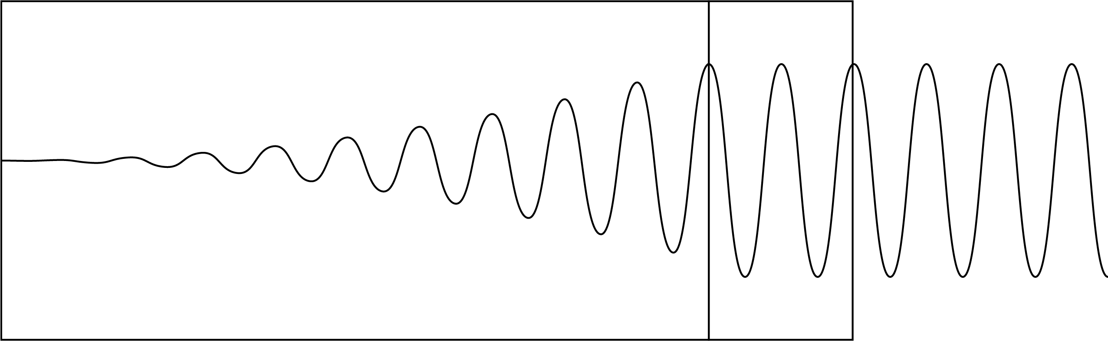
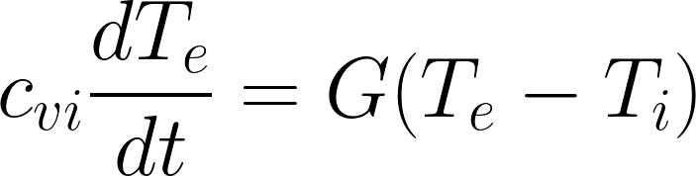
Implementation of a One-Dimensional Electromagnetic Wave Solver in Initial Plasma Formation Modeling
Nicholas Davila¹, Ka Ming Woo² ¹Department of Physics, College of Natural Sciences, The University of Texas at Austin
¹Princeton Plasma Physics Laboratory
²Laboratory for Laser Energetics, University of Rochester
Abstract
Methods and Figures
Conclusion and Results
The modeling of initial plasma formation (IPF) provides a pathway for understanding the ultrafast dynamics of laser–material interactions. A one-dimensional electromagnetic wave solver has been developed using the finite-difference time-domain (FDTD) method to accurately model laser propagation in metals and dielectrics. Laser absorption is modeled by the collisional damping of the light wave, which is determined by the dielectric function of the materials. A two-temperature model is employed to describe the heat transfer between electrons and lattices/ ions. Differences in the heat transfer dynamics to electrons and ions modeled by the wave solver and a ray trace approach are compared. The objective of this approach is to enhance the modeling accuracy of laser-matter interactions in inertial confinement fusion (ICF) codes.
The explicit Finite-Difference Time-Domain (FDTD) scheme was implemented to model the electromagnetic wave propagation in medium. The explicit scheme imposes a constraint on the time-step size “dt” so that the wave propagation distance within an allowed time-step size cannot exceed the grid size “dx” according to the Courant Fl Condition (CFL). The allowed wave propagation step size within a grid size “dx” is controlled by the CFL number.
CFL
Why not 351nm?
Figure 2: Stencil diagram of the explicit finite difference scheme
Eq 4 and 5
State definition for permitvitiy (epsilon) and sigma
Background
Sigma is conductivity
Figure 3: Simulation of light wave propagating into material undergoing collisional damping.
GHOST CELL
The 1-D electromagnetic wave solver was implemented over 10 cycles for a complex refractive index n = n_R + n_I = 1 + 0.125 and wavelength lambda = 351 nm. As shown in Fig. (3) we were able to accurately model the attenuation of the 1-D light wave propagating into a material. The comparison of the heat transfer dynamics modeled by the wave solver compared to a ray trace approach are still in progress.
SIMULATION SPACE
Eq 4 define epsilon, mu, sigma and P_NL.
(DEFINE 4 Variables in eq 4). Eq (4) describes the propagation of light waves in material. The light wave interacts with electrons and sets them into oscillations along the electric field vector direction. The oscillating electrons then collide with neighboring atoms. Consequently, the light wave’s energy is then transferred from photons to electrons and then ions. This process is known as the collisional damping of light waves and is uniquely described by the dielectric function $ε=n^{2}$. In our 1-D IPF modeling, the non-linear polarization term $P_{NL}$and the transient current term driven by the conductivity $σ$ are neglected in Eq (5). The incident electric field is described by:
Future Work
Figure 1: Diagram of laser propagation and its interaction with material. This was the outcome we were looking for. The modeling equations are given below.
For future work, we can extend our solver into 2-D and 3-D to model the multi-dimensional wave propagation. We also plan to employ a two-temperate model to study and compare the heat transfer dynamics in material modeled by the wave solver and the ray tracing approach.
Eq 6
NUMBER EQUATIONS!
The complex-valued incident electric field provides the initial boundary condition in the ghost cells, whereas the electric field inside the computational domain is initialized as zeroes. The Fourier analysis is applied to model the amplitude of the electric field vector. In 1-D, the reduced wave equation becomes:
T_i TYPO
References
Eq 7
[1] L. V. Keldysh “Ionization in the Field of a Strong Electromagnetic Wave and modern physics of atomic interaction with a strong laser field” Journal of Experimental and Theoretical Physics, 122, 449–455 (2016).
Equations (1) – (3) contribute to our 1-D initial plasma formation (IPF) modeling. In the first equation, $E$ is the electric field, $c$ is the speed of light, $n$ is the complex refractive index where its real part accounts for reflections and transmissions while the imaginary part accounts for absorptions. In Eqs. (2) - (3) $c_{ve}$ and $c_{vi}$ are electron heat capacities and ion heat capacities at the constant volume, respectively. $G$ is the energy exchange rate between the electron temperature $T_{e}$ and the ion temperature $T_{i}.$ The Drude model is used to model the rate of laser energy absorption caused by the collisional damping of the light wave, which is determined by the source term $S$. Modeling of multi-photon ionization can be found in Ref [1].
Equation (7) accepts an exponentially decaying or growing solution. A positive sign in the refractive index corresponds to a growing wave amplitude whereas the negative sign corresponds to a decaying wave amplitude. In the absence of wave amplification processes caused by the nonlinear polarization effect, the negative sign is the correct solution to describe an attenuating wave for laser propagations in material. During the numerical update, the selection of the sign depends on the boundary condition.
Acknowledgments
This material is supported by the Department of Energy National Nuclear Security Administration under Award No. DE-NA0003856. This work was made possible by funding from the Department of Energy for the Plasma and Fusion Undergraduate Research Opportunities (PFURO) program. This work is supported by the US DOE Contract No. DE-AC02-09CH11466.
MINUS SIGN ONLY!

Slide 3
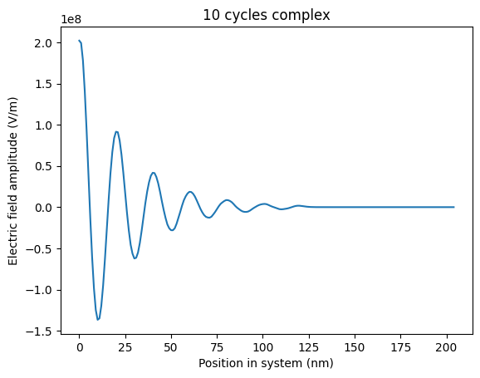
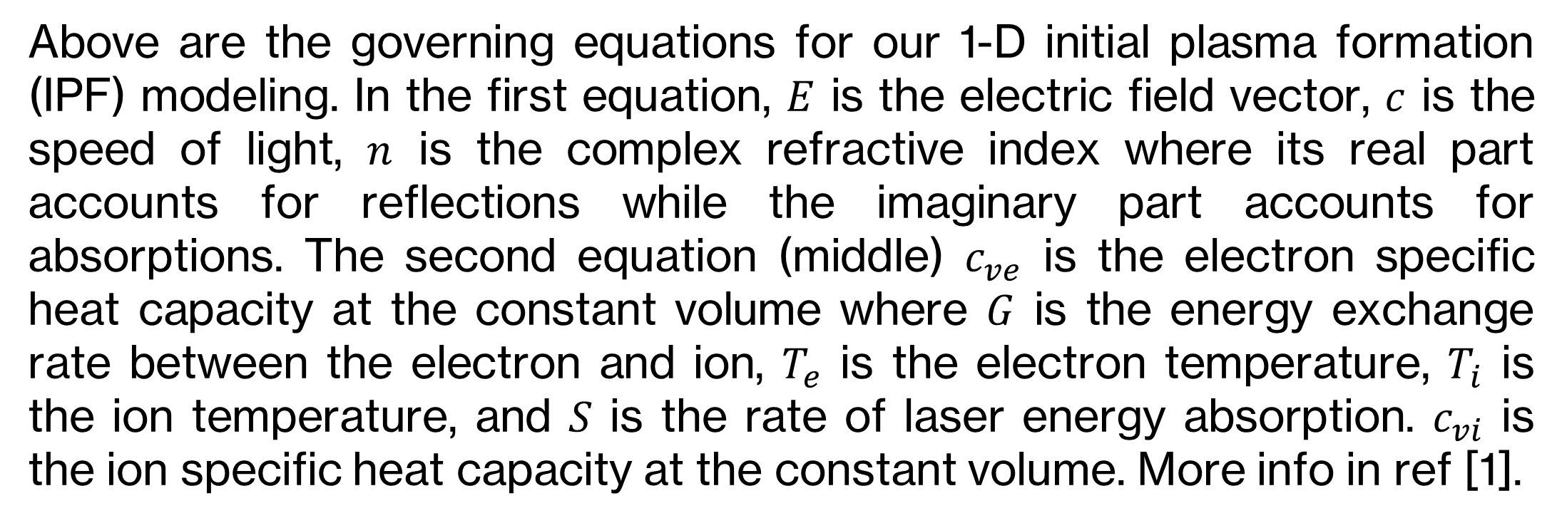
Implementation of a One-Dimensional Electromagnetic Wave Solver in Initial Plasma Formation Modeling
Nicholas Davila¹, Ka Ming Woo² ¹Department of Physics, College of Natural Sciences, The University of Texas at Austin
¹Princeton Plasma Physics Laboratory
²Laboratory for Laser Energetics, University of Rochester
Abstract
Methods and Figures
Conclusion and Results
The modeling of initial plasma formation (IPF) provides a pathway for understanding the ultrafast dynamics of laser–material interactions. A one-dimensional electromagnetic wave solver has been developed using the finite-difference time-domain (FDTD) method to accurately model laser propagation in metals and dielectrics. Laser absorption is modeled by the collisional damping of the light wave, which is determined by the dielectric function of the materials. A two-temperature model is employed to describe the heat transfer between electrons and lattices ions. Differences in the heat transfer dynamics to electrons and ions modeled by the wave solver and a ray trace approach are compared. The objective of this approach is to enhance the modeling accuracy of laser-matter interactions in inertial confinement fusion (ICF) codes.
We implemented an explicit Finite-Difference Time-Domain (FDTD) scheme to model the electromagnetic wave propagation in medium. The word “explicit” means that the time-step size “dt” is strictly controlled by Courant–Friedrichs–Lewy (CFL) condition so that the wave propagation distance within an allowed time-step size cannot exceed the grid size “dx”. Any form of hyperbolic PDEs are updated explicitly such as Euler equations in the computational fluid dynamics (CFD). The allowed wave propagation step size within a grid size “dx” is controlled by the CFL number.
figures
Background
Vitam voloria con et, cum laboreium, nam cum, quat paris as core volorest, sust exceatur antio ea voluptas eumquatendit quas doluptatet aut landignam que lantur sania dem escidit min reruptiaero velis maximus aut que pe aliquas sequidisit, omnient hit lam
Cartoon
As the light waves propagate inside a material, the light wave interacts with electrons and so the electrons are set into oscillations along the electric field vector direction. The oscillating electrons then collide with neighboring atoms and so the light wave’s energy is transferred from the electric field to electrons and then ions eventually. This process is known as the collisional damping of light waves and is described by a complex refractive index. The incident electric field is described by a complex number. The complex-valued incident electric field provides the initial boundary condition in the ghost cells. However, the direct implementation of a complex refractive index leads to oscillatory numerical solutions. A Fourier analysis is applied to understand this phenomenon. In 1-D, the reduced wave equation becomes:
RESULTS!
Future Work
We model 1-D initial plasma formation to observe numerical performance of an explicit finite-difference solver. For our future work we can extend our solver to 2-D and 3-D by simply adding terms to our solver.
References
[1] Fedorov, M. V. (2016). L. V. Keldysh’s “Ionization in the Field of a Strong Electromagnetic Wave” and modern physics of atomic interaction with a strong laser field. Journal of Experimental and Theoretical Physics, 122(3), 449–455. doi:10.1134/S1063776116030043
[2] Two temperature model
Above are the governing equations for our 1-D initial plasma formation (IPF) modeling. In the first equation, $E$ is the electric field vector, $c$ is the speed of light, $n$ is the complex refractive index where its real part accounts for reflections while the imaginary part accounts for absorptions. The second equation (middle) $c_{ve}$ is the electron specific heat capacity at the constant volume where $G$ is the energy exchange rate between the electron and ion, $T_{e}$ is the electron temperature, $T_{i}$ is the ion temperature, and $S$ is the rate of laser energy absorption. $c_{vi}$ is the ion specific heat capacity at the constant volume. More info in ref [1].
Acknowledgments
This material is supported by the Department of Energy National Nuclear Security Administration under Award No. DE-NA0003856. This work was made possible by funding from the Department of Energy for the Plasma and Fusion Undergraduate Research Opportunities (PFURO) program. This work is supported by the US DOE Contract No. DE-AC02-09CH11466.
Figure 1: Simulation of light wave propagating into material undergoing collisional damping.

Slide 4


Slide 5
Implementation of a One-Dimensional Electromagnetic Wave Solver in Initial Plasma Formation Modeling
Nicholas Davila¹, Ka Ming Woo² ¹Department of Physics, College of Natural Sciences, The University of Texas at Austin
¹Princeton Plasma Physics Laboratory
²Laboratory for Laser Energetics, University of Rochester
Introduction
Figures and Results
Conclusion
Imintem quas porro debitis itius, nus id quat animus auda platust et imin perovitasped es ipsus mo maios eume di ut a dolupit, sequam, serio bea natis dolupta simperiae nate molorum eati ulparis magnieniam, to intotatur?
Sunto into temperi aturerum et identio nsectatem quo dolorum fuga. Itiatur, quam vendus quodis reria volupienis con posto dolor sam debit experumet odit ut id molorrum que quam fuga. Et volorioraes alit, que plitati onemporro entorio rumendi simenimus mossimus re officit mo officae etur, volorem et optae. Ut ipsam esto temquas dolores sitiandi arum ipicien debisimus doluptatius.
As verepe sectis enda di incto etusda delectet eaque simusda ndanimus, sin cori rem id maximillut hari con ea quiam quam et enduci idunt, corecta alicimp oriaeperum iusaeped unt quis et ut abor ame alis utatur as senet a quibus dolutatur sedit aliam apienda versper feriti delia pa dolo quamus arum es endellu pisquia aditatur audam earupid quo quunt odigniscil earum verios nonsequam duciis eta quibus dolutatur sedit aliam apienda versper feriti delia pa dolo quamus arum es endellu pisquia aditatur
figures
figures
Research Goal
figures
figures
Ugiatempore evenis rae doluptatum fugiam earchitiam dit, tempe susdam qui asimin et quissequam la ni ipsunt.
Ditat que a quibus dolutatur sedit aliam apienda versper feriti delia pa dolo quamus arum es endellu pisquia aditatur audam earupid quo quunt odigniscil earum verios nonsequam duciis et
Vitam voloria con et, cum laboreium, nam cum, quat paris as core volorest, sust exceatur antio ea voluptas eumquatendit quas doluptatet aut landignam que lantur sania dem escidit min reruptiaero velis maximus aut que pe aliquas sequidisit, omnient hit lam
As verepe sectis enda di incto etusda delectet eaque simusda ndanimus, sin cori rem id maximillut hari con ea quiam quam et enduci idunt, corecta alicimp oriaeperum iusaeped unt quis et ut abor ame alis utatur as senet a quibus dolutatur sedit aliam apienda versper feriti delia pa dolo quamus arum es endellu pisquia aditatur audam earupid quo quunt odigniscil earum verios nonsequam duciis et
Methods
Acknowledgments
Ga. Oviduntusam exerum fugitat quae el exersperum qui corum sam sitas que officiat am el inust dunt mint ut vel il mintis es vel maxim dolupiet, aut quatur aborem quiae explitatur sum venihit quo con cusda volorum quia qui conessunt vel etur? Quis nullitae porunto mod maiorio ex es dolupis eum
figures
Vitam voloria con et, cum laboreium, nam cum, quat paris as core volorest, sust exceatur antio ea voluptas eumquatendit quas doluptatet aut landignam que lantur sania dem escidit min reruptiaero velis maximus aut que pe aliquas sequidisit, omnient hit lam eicias modio con nisin pediam, ent, cust accaborit odio corehen dendae nonet eliquam, aperorepe autatem voles int odic tem nis dolorrum que cores doluptaturi utemolorum imusam, idendaecabo. Nam quo moluptatur? aut omnienderi sinvele stiam, cus eos sime sed que occupta temquia nobisciur? Quis dolenem oluptam ne nonessumqui
figures
References
As verepe sectis enda di incto etusda delectet eaque simusda ndanimus, sin cori rem id maximillut hari con ea quiam quam et enduci idunt, corecta alicimp oriaeperum iusaeped unt quis et ut abor ame alis utatur as senet a quibus dolutatur sedit aliam apienda versper feriti delia pa dolo quamus arum es endellu pisquia aditatur audam earupid quo quunt odigniscil earum verios nonsequam duciis et apienda versper feriti delia pa dolo quamus arum es endellu pisquia aditatur audam earupid quo quunt odigniscil earum verios nonsequam
Vitam voloria con et, cum laboreium, nam cum, quat paris as core volorest, sust exceatur antio ea voluptas eumquatendit quas doluptatet aut landignam que lantur sania dem escidit min reruptiaero velis maximus aut que pe aliquas sequidisit, omnient hit lam eicias modio con nisin pediam, ent, cust accaborit odio corehen dendae nonet eliquam, aperorepe autatem voles int odic tem nis dolorrum que cores doluptaturi utemolorum imusam, idendaecabo. Nam quo moluptatur?
eicias modio con nisin pediam, ent, cust accaborit odio corehen dendae nonet eliquam, aperorepe autatem voles int odic tem nis dolorrum que

Slide 6
Implementation of a One-Dimensional Electromagnetic Wave Solver in Initial Plasma Formation Modeling
Nicholas Davila¹, Ka Ming Woo² ¹Department of Physics, College of Natural Sciences, The University of Texas at Austin
¹Princeton Plasma Physics Laboratory
²Laboratory for Laser Energetics, University of Rochester
Introduction
Figures and Results
Conclusion
Imintem quas porro debitis itius, nus id quat animus auda platust et imin perovitasped es ipsus mo maios eume di ut a dolupit, sequam, serio bea natis dolupta simperiae nate molorum eati ulparis magnieniam, to intotatur?
Sunto into temperi aturerum et identio nsectatem quo dolorum fuga. Itiatur, quam vendus quodis reria volupienis con posto dolor sam debit experumet odit ut id molorrum que quam fuga. Et volorioraes alit, que plitati onemporro entorio rumendi simenimus mossimus re officit mo officae etur, volorem et optae. Ut ipsam esto temquas dolores sitiandi arum ipicien debisimus doluptatius.
As verepe sectis enda di incto etusda delectet eaque simusda ndanimus, sin cori rem id maximillut hari con ea quiam quam et enduci idunt, corecta alicimp oriaeperum iusaeped unt quis et ut abor ame alis utatur as senet a quibus dolutatur sedit aliam apienda versper feriti delia pa dolo quamus arum es endellu pisquia aditatur audam earupid quo quunt odigniscil earum verios nonsequam duciis eta quibus dolutatur sedit aliam apienda versper feriti delia pa dolo quamus arum es endellu pisquia aditatur
figures
figures
Research Goal
figures
figures
Ugiatempore evenis rae doluptatum fugiam earchitiam dit, tempe susdam qui asimin et quissequam la ni ipsunt.
Ditat que a quibus dolutatur sedit aliam apienda versper feriti delia pa dolo quamus arum es endellu pisquia aditatur audam earupid quo quunt odigniscil earum verios nonsequam duciis et
Vitam voloria con et, cum laboreium, nam cum, quat paris as core volorest, sust exceatur antio ea voluptas eumquatendit quas doluptatet aut landignam que lantur sania dem escidit min reruptiaero velis maximus aut que pe aliquas sequidisit, omnient hit lam
As verepe sectis enda di incto etusda delectet eaque simusda ndanimus, sin cori rem id maximillut hari con ea quiam quam et enduci idunt, corecta alicimp oriaeperum iusaeped unt quis et ut abor ame alis utatur as senet a quibus dolutatur sedit aliam apienda versper feriti delia pa dolo quamus arum es endellu pisquia aditatur audam earupid quo quunt odigniscil earum verios nonsequam duciis et
Methods
Acknowledgments
Ga. Oviduntusam exerum fugitat quae el exersperum qui corum sam sitas que officiat am el inust dunt mint ut vel il mintis es vel maxim dolupiet, aut quatur aborem quiae explitatur sum venihit quo con cusda volorum quia qui conessunt vel etur? Quis nullitae porunto mod maiorio ex es dolupis eum
figures
Vitam voloria con et, cum laboreium, nam cum, quat paris as core volorest, sust exceatur antio ea voluptas eumquatendit quas doluptatet aut landignam que lantur sania dem escidit min reruptiaero velis maximus aut que pe aliquas sequidisit, omnient hit lam eicias modio con nisin pediam, ent, cust accaborit odio corehen dendae nonet eliquam, aperorepe autatem voles int odic tem nis dolorrum que cores doluptaturi utemolorum imusam, idendaecabo. Nam quo moluptatur? aut omnienderi sinvele stiam, cus eos sime sed que occupta temquia nobisciur? Quis dolenem oluptam ne nonessumqui
figures
References
As verepe sectis enda di incto etusda delectet eaque simusda ndanimus, sin cori rem id maximillut hari con ea quiam quam et enduci idunt, corecta alicimp oriaeperum iusaeped unt quis et ut abor ame alis utatur as senet a quibus dolutatur sedit aliam apienda versper feriti delia pa dolo quamus arum es endellu pisquia aditatur audam earupid quo quunt odigniscil earum verios nonsequam duciis et apienda versper feriti delia pa dolo quamus arum es endellu pisquia aditatur audam earupid quo quunt odigniscil earum verios nonsequam
Vitam voloria con et, cum laboreium, nam cum, quat paris as core volorest, sust exceatur antio ea voluptas eumquatendit quas doluptatet aut landignam que lantur sania dem escidit min reruptiaero velis maximus aut que pe aliquas sequidisit, omnient hit lam eicias modio con nisin pediam, ent, cust accaborit odio corehen dendae nonet eliquam, aperorepe autatem voles int odic tem nis dolorrum que cores doluptaturi utemolorum imusam, idendaecabo. Nam quo moluptatur?
eicias modio con nisin pediam, ent, cust accaborit odio corehen dendae nonet eliquam, aperorepe autatem voles int odic tem nis dolorrum que

Slide 7
Implementation of a One-Dimensional Electromagnetic Wave Solver in Initial Plasma Formation Modeling
Nicholas Davila¹, Ka Ming Woo² ¹Department of Physics, College of Natural Sciences, The University of Texas at Austin
¹Princeton Plasma Physics Laboratory
²Laboratory for Laser Energetics, University of Rochester
logo
logo
Introduction
Figures and Results
Conclusion
Imintem quas porro debitis itius, nus id quat animus auda platust et imin perovitasped es ipsus mo maios eume di ut a dolupit, sequam, serio bea natis dolupta simperiae nate molorum eati ulparis magnieniam, to intotatur?
Sunto into temperi aturerum et identio nsectatem quo dolorum fuga. Itiatur, quam vendus quodis reria volupienis con posto dolor sam debit experumet odit ut id molorrum que quam fuga. Et volorioraes alit, que plitati onemporro entorio rumendi simenimus mossimus re officit mo officae etur, volorem et optae. Ut ipsam esto temquas dolores sitiandi arum ipicien debisimus doluptatius.
As verepe sectis enda di incto etusda delectet eaque simusda ndanimus, sin cori rem id maximillut hari con ea quiam quam et enduci idunt, corecta alicimp oriaeperum iusaeped unt quis et ut abor ame alis utatur as senet a quibus dolutatur sedit
figures
figures
Research Goal
Vitam voloria con et, cum laboreium, nam cum, quat paris as core volorest, sust exceatur antio ea voluptas eumquatendit quas doluptatet aut landignam que lantur sania dem escidit min reruptiaero velis maximus aut que pe aliquas sequidisit, omnient hit lam eicias modio con nisin pediam, ent, cust accaborit odio corehen dendae nonet eliquam, aperorepe autatem
ipsam esto temquas dolores sitiandi arum ipicien debisimus doluptatius.
As verepe sectis enda di incto etusda delectet eaque simusda ndanimus, sin cori rem id maximillut hari con ea quiam quam et enduci idunt, corecta alicimp oriaeperum iusaeped unt quis et ut abor ame alis utatur as senet a quibus dolutatur sedit
figures
figures
figures
Methods
Acknowledgments
figures
Imintem quas porro debitis itius, nus id quat animus auda platust et imin perovitasped es ipsus mo maios eume di ut a dolupit, sequam, serio bea natis dolupta simperiae nate molorum eati ulparis magnieniam, to intotatur?
Sunto into temperi aturerum et identio nsectatem quo dolorum fuga. Itiatur, quam vendus quodis reria volupienis con posto dolor sam debit experumet odit ut id molorrum que quam fuga. Et volorioraes alit, que plitati onemporro entorio rumendi simenimus mossimus re officit mo officae etur, volorem et optae. Ut ipsam esto temquas dolores sitiandi arum ipicien debisimus doluptatius.
As verepe sectis enda di incto etusda delectet eaque simusda ndanimus, sin cori rem id maximillut hari con ea quiam quam et enduci idunt, corecta alicimp oriaeperum et
Vitam voloria con et, cum laboreium, nam cum, quat paris as core volorest, sust exceatur antio ea voluptas eumquatendit quas doluptatet aut landignam que lantur sania dem escidit min reruptiaero velis maximus aut que pe aliquas sequidisit, omnient hit lam eicias modio con nisin pediam, ent, cust accaborit odio corehen dendae nonet eliquam, aperorepe autatem voles int odic tem nis dolorrum que cores doluptaturi utemolorum imusam,
figures
References
Vitam voloria con et, cum laboreium, nam cum, quat paris as core volorest, sust exceatur antio ea voluptas eumquatendit quas doluptatet aut landignam que lantur sania dem escidit min reruptiaero velis maximus aut que pe aliquas sequidisit, omnient hit lam eicias modio con nisin pediam, ent, cust accaborit odio corehen dendae nonet eliquam, aperorepe autatem voles int odic tem nis dolorrum que cores doluptaturi utemolorum imusam, idendaecabo. Nam quo moluptatur?
eicias modio con nisin pediam, ent, cust accaborit
Ga. Oviduntusam exerum fugitat quae el exersperum qui corum sam sitas que officiat am el inust dunt mint ut vel il mintis es vel maxim dolupiet

